Slide 1

Research Design
Study the Effect of LinkedIn Premium Career
Team FP10
Kanyarat Suwannama Mia Szpolski
Nathan Ge
Usra Khan
Zemei Jamie Liang

Slide 2


Summary & Research Questions

Slide 3

Executive Summary
Transitioning from college or graduate school into the working world can be very challenging.
LinkedIn is the world’s leading professional network, its resources helps bridge the gap between job seekers and job recruiters.
Is Linkedin Premium the answer to students stepping into the working world?
This study examines the efficacy of LinkedIn Premium on delivering direct outcomes translated into connections and job or internship interviews to college students.

Slide 4
Research
Questions
Research Question 1
‘Could the LinkedIn Premium 3 month free trial be a better alternative to help students receive more job interviews on average as opposed to students not using the premium feature?’.
Importance of the study:
Will a premium membership be beneficial for a college student in terms of finding jobs and internships, connecting with people, and obtaining more opportunities in their fields of interest?
Research Question 2
‘Relative to the LinkedIn Basic account, is LinkedIn Premium providing a greater average of networking-based responses?’.
Research Question 3
‘Does the average student feel more satisfied with the LinkedIn Premium as opposed to their LinkedIn Basic account enough to buy the premium subscription?’.

Slide 5
Literature Review

Slide 6




LinkedIn Stats
87% of recruiters regularly use LinkedIn.
A study conducted by Statistic Brain Research Institute found that 122 million people got an interview thanks to their engagement on LinkedIn.
3 people are hired through LinkedIn every minute.
College students and recent graduates are the fastest-growing user demographic on the site.
50% of US college graduates are LinkedIn users.
39% of LinkedIn users pay for LinkedIn Premium.

Slide 7

Literature Review
Study by Carmack and Heiss
Students participate in social networking sites due to the need to maintain interpersonal connectivity, social enhancement value, and entertainment value.
Study by Ali Raza, Qazi, Umer, Akram Khan,
Students agreed on the effectiveness of LinkedIn as a medium for finding jobs and internships.
Past behaviors, attitudes, perceived behavioral control, and actual behavioral control directly affect the effectiveness of LinkedIn to help students find internships and jobs.
Study 3 by Hong and Ping Chang
Some of the determinant factors for consumer attitude and intention toward free trial of technology-based services were perceived usefulness, ease of use, risk, and social influence.

Slide 8
Variables & Operational Procedures

Slide 9




Treatment
(Independent Variables)
Outcome
(Dependent Variables)
Survey Questions
During the past 3 months, approximately how many job interviews have you received through applying for jobs on LinkedIn?
During the past 3 months, approximately how many new connections have you made through Linkedin?
How is your overall satisfaction with your LinkedIn account on a scale from 1 (Very Dissatisfied) to 5 (Very Satisfied) ?
How useful is the in-app communication tool to help you connect with professionals on a scale from 1 (Very Dissatisfied) to 5 (Very Satisfied)?
How do you find LinkedIn job recommendations on a scale from 1 (Very Dissatisfied) to 5 (Very Satisfied) ?
How do you receive LinkedIn notifications from InMails messages and Email on a scale from 1 (Very Dissatisfied) to 5 (Very Satisfied) ?
How do you learn from LinkedIn insights about jobs and industry on a scale from 1 (Very Dissatisfied) to 5 (Very Satisfied) ?
Basic Account (control group)
Premium Career Account (treatment group)
The number of job interviews received
The response rate from the networkings (proportion or %)
Satisfaction rating scale: from 1 (very dissatisfied) to 5 (very satisfied)
Feature | Basic Account | Premium Career Account
Build a Network | Through mutual connections only. | Without needing to be introduced or connected.
See Who has viewed your profile | 5 views in the last 90 days. | Unlimited views in the last 90 days.
InMail | Can send only. | Both send and receive 5 InMail messages per month
Open Profile | - | Allow any LinkedIn member to reach out without InMail credits.
Advanced Search | - | More ability to search for company size, ranking, seniority, and etc.
Featured Applicant Status | - | Job applications automatically sit above basic members.
Access to Salary Insights | - | Provide detailed breakdown of salaries by job title and location.
Top Applicant | - | Access to learning courses to build new skills.
LinkedIn Learning | - | 16,000 courses online learning with on-demand, video-based content.
Price | Free | $29.99/month ($239.88/year for the annual plan).

Slide 10

Operational Procedures
1
2
3
4
5
S T E P
S T E P
S T E P
S T E P
S T E P
Partner with LinkedIn to select sample students
Offer half the sample students with LinkedIn Premium Career profile
partner with LinkedIn to send out survey
Collect and study the data
Conduct the survey
Survey for satisfaction; interview and network amount
Collect the data and study the outcomes
Active basic profile users that have a decent complete profile
Free Trial for a Fall semester (3 months)
Survey type: In-mail survey through LinkedIn app
Statistical Analysis Plan
Two-Sample One Sided t-Test

Slide 11


Limitations & Uncertainties

Slide 12

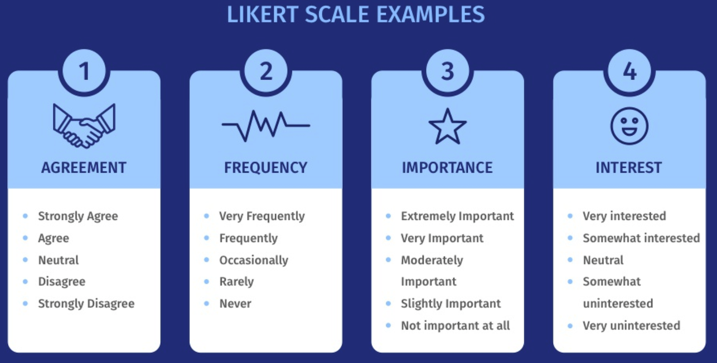
Limitations & Uncertainties
Response Bias
Renders participants to answer inaccurately
Skews data and conveys distorted sentiment
Nonrandom deviation of the answers from their true value
Likert Scale Disadvantages
Two individuals can get the same value in the Likert scale by having chosen different options.
It is difficult to treat neutral opinions as “Neither agree or disagree”.
Respondents tend to agree to the statements showed, also known as the phenomenon of acquiescence bias.

Slide 13
Simulation of Effects

Slide 14
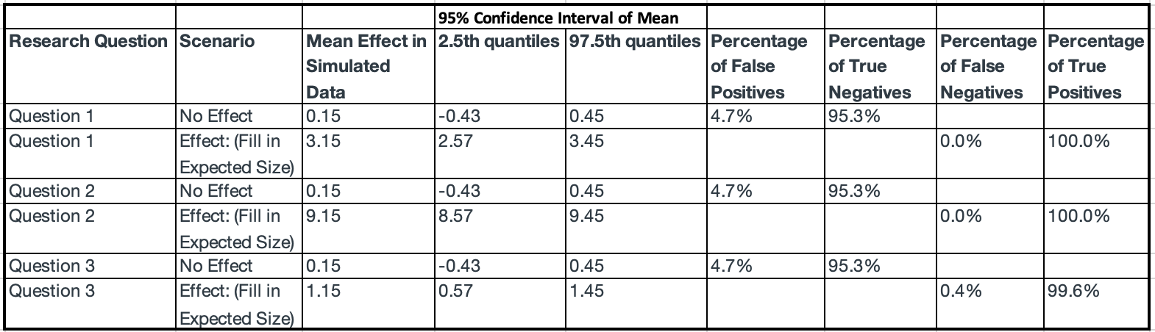
Simulation of Effects

Slide 15



THANK YOU!

